Slide 1
Economic Data
Analysis
Economic Impact on Consumer Auto Loans
Project 1- Group 7
Andrew Jaynes, Riley Hutchinson, Brian Buxton

Slide 2
Economic Impact on Consumer Auto Loans
Project Goal: Outline of the project is to understand how economic factors influence consumer auto loans.
Key Focus Areas: GDP, Loan Amounts, Finance Rates, Delinquency Rates
Relevance: Understanding these relationships offers insights into consumer behavior and the stability of the auto loan market.
Methodology: Historical data review, focusing on correlations between economic indicators and loan trends.
Notes:
Hello all,
Welcome to group number 7, our project was an Economic Data Analysis, which aims to uncover how various economic factors influence consumer auto loans.
We’re focusing on four key areas: GDP, loan amounts, finance rates, and delinquency rates. By examining these indicators, we can begin to identify patterns and correlations that reveal how economic health impacts consumer lending trends.
For instance, how do changes in GDP influence the amount consumers are willing to borrow? Or, how do rising finance rates impact loan delinquencies? Shedding light on these trends may help us understand the broader auto loan market and help us make better, more informed decisions as consumers.
The methodology for this project involves a historical review of data. By studying trends over time, we were able to explore correlations between these economic indicators and loan behaviors. This approach allowed us to see not only the short-term effects but also any long-term shifts in consumer lending patterns that could signal changes in the market’s stability

Slide 3
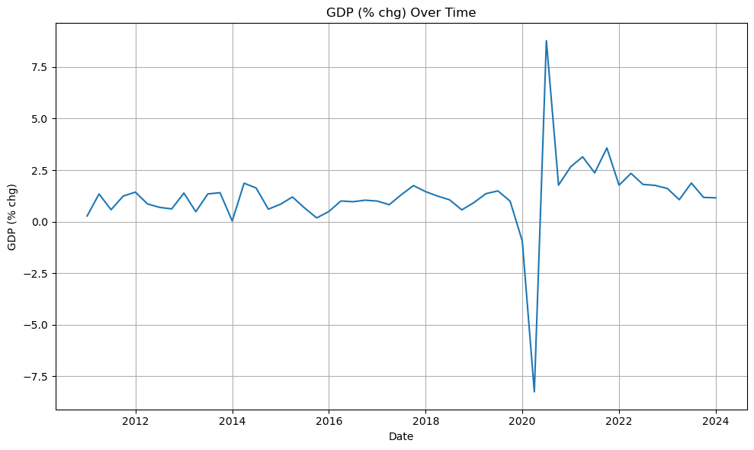
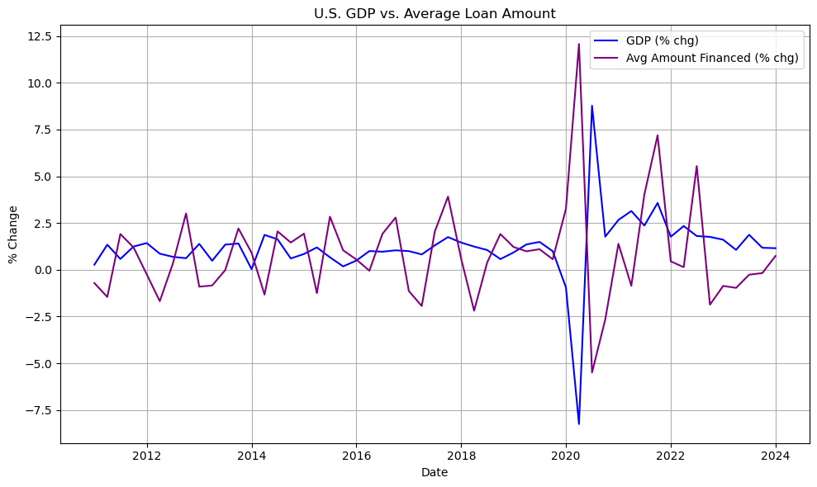
U.S. GDP and Its Influence on Key Loan Indicators
GDP Overview: GDP reflects economic health and growth. Rising GDP often correlates with increased consumer spending and borrowing.
Consumer Lending Context: Typically, GDP growth supports greater consumer lending, while contractions may lead to borrowing declines.
Link to Auto Loans: GDP changes directly influence consumer demand for auto loans, as a stronger economy often increases loan demand.
Data Highlights: Our analysis found a moderate negative correlation (r = -0.58) between GDP growth and average loan amounts. As GDP increased, consumers borrowed smaller amounts for auto loans.

Slide 4
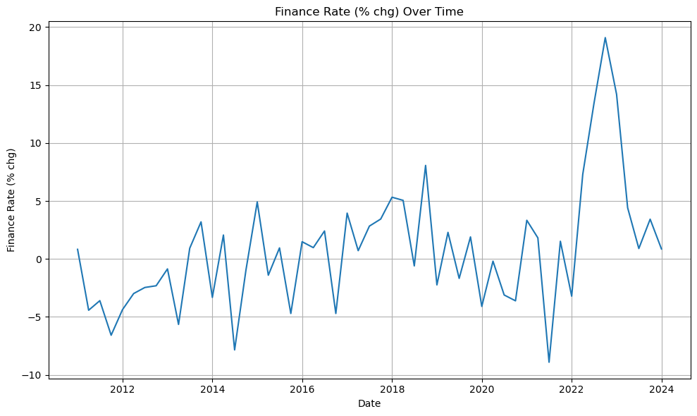
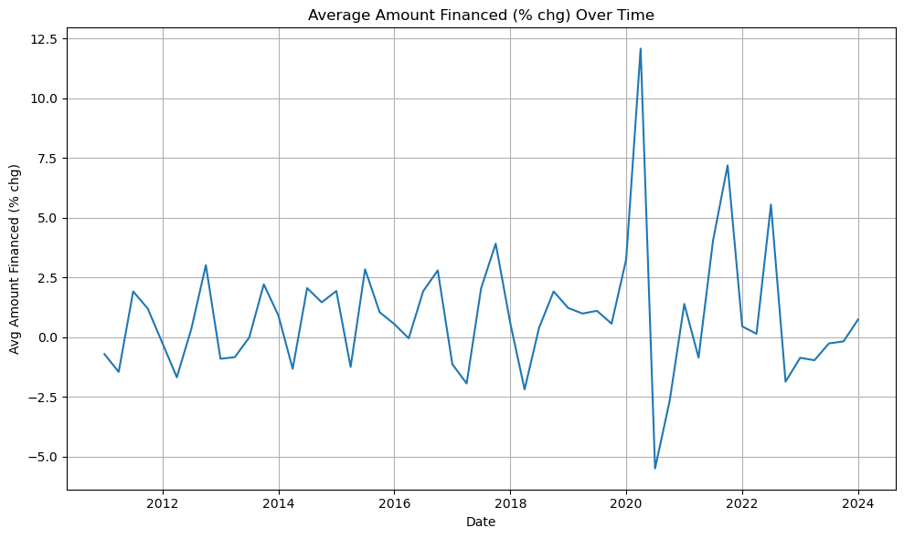
Analysis of Average Loan Amounts and Finance Rates
Loan Amount Trends: Average loan amounts showed a downward trend as GDP grew, suggesting consumers might be cautious in higher-growth economies or have access to other financing sources.
Finance Rate Trends: Over time, finance rates fluctuate, showing weak correlation with loan amounts (r = -0.03).
Impact of Economic Conditions: Lower finance rates generally coincide with economic growth, encouraging borrowing. However, this effect was minimal in influencing average loan amounts in our data.
Consumer Insights: Consumers may not significantly adjust loan rates in response to finance amount changes, suggesting other factors impact loan rate decisions.

Slide 5
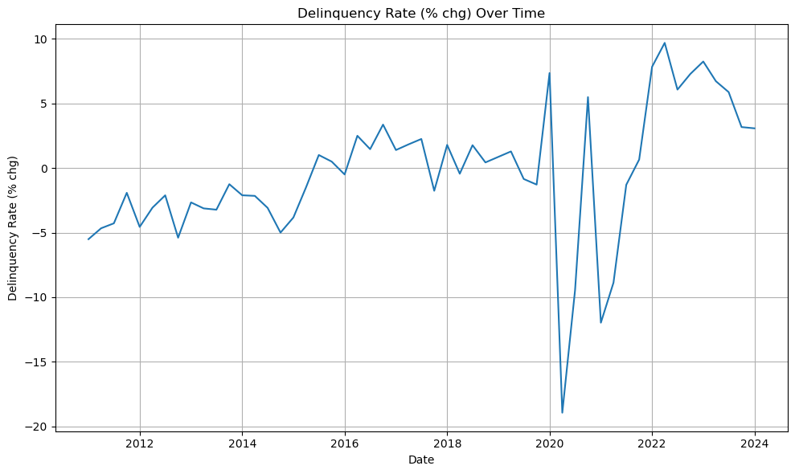
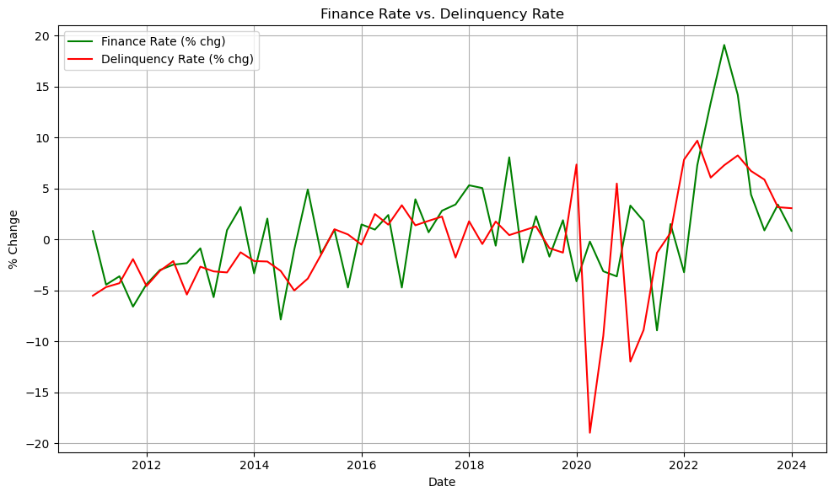
Consumer Delinquency Rates: Trends and Risks
Delinquency Rate: Defined as the percentage of loans overdue, it’s a critical risk metric for lenders.
Delinquency Trends: The data shows that delinquency rates moderately correlate with finance rate changes (r = 0.36), suggesting rising finance rates increase delinquency risks.
Economic Impact: Economic downturns or higher interest rates put pressure on borrowers, leading to higher delinquency rates.
Risks to Lenders and Consumers: High delinquency rates impact lender profitability and can signal economic stress, affecting both lenders and broader economic stability.

Slide 6
Conclusion: Key Insights and Market Implications
Summary of Findings:
GDP and Loan Amounts: A moderate negative correlation indicates that higher GDP might reduce average loan amounts.
Finance Rates and Delinquency: Positive correlation highlights a risk as finance rates rise, delinquency rates increase.
Market Implications: These trends suggest that economic growth may not always drive higher loan amounts, while rising rates are a risk factor for loan defaults.
Future Considerations: Monitor changes in interest rates and economic shifts as they may impact auto loan behavior.
Stakeholder Takeaway: Insights are critical for lenders, policymakers, and consumers, indicating areas to watch for lending risk and consumer financial health.
Indicator Pair | R-value | P-value | Relationship
GDP & Delinquency Rate | +0.20 | 0.14 | Weak positive correlation
GDP & Avg Amount Financed | -0.58 | <0.001 | Moderate negative correlation
Finance Rate & Avg Loan Amount | -0.03 | 0.83 | Very weak correlation
Finance Rate & Delinquency | +0.36 | 0.009 | Moderate positive correlation

Slide 7
Questions

